Slide 1

Game Analysis
Mentorness Internship Project [SQL]
This Photo by Unknown Author is licensed under CC BY-SA

Slide 2
Agenda
Introduction
Analysis
Summary

Slide 3
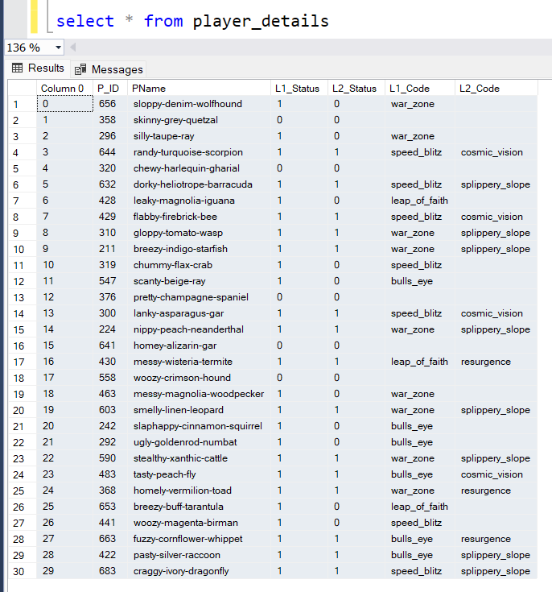
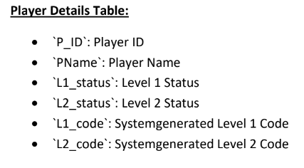
Player Table

Slide 4
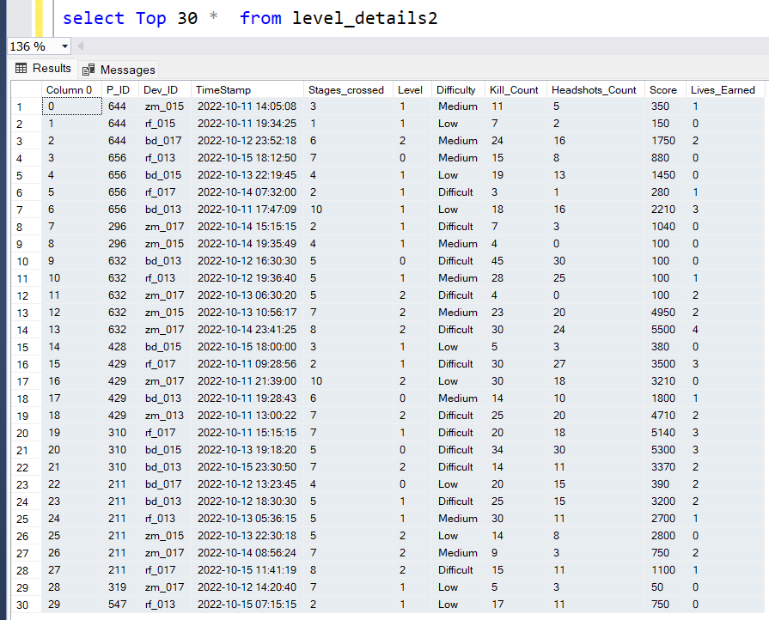
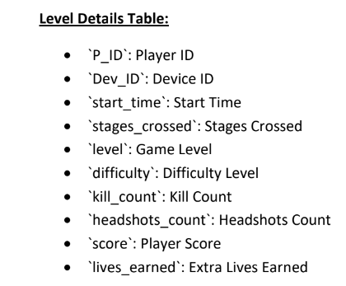
Level_details Table

Slide 5
Introduction
-- 1) Players play a game divided into 3-levels (L0,L1 and L2)
-- 2) Each level has 3 difficulty levels (Low, Medium, High)
-- 3) At each level, players have to kill the opponents using guns/physical fight
-- 4) Each level has multiple stages at each difficulty level.
-- 5) A player can only play L1 using its system generated L1_code.
-- 6) Only players who have played Level1 can possibly play Level2.
-- using its system generated L2_code.
-- 7) By default a player can play L0.
-- 8) Each player can login to the game using a Dev_ID.
-- 9) Players can earn extra lives at each stage in a level.

Slide 6
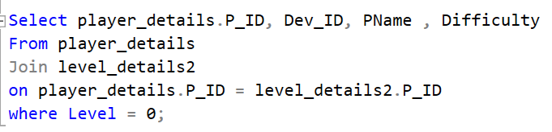
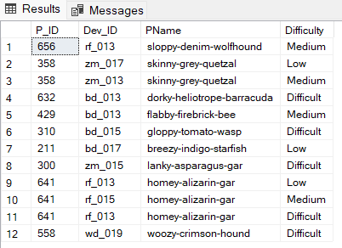
Analysis
Q1- Extract P_ID,Dev_ID,PName and Difficulty_level of all players at level 0
output

Slide 7
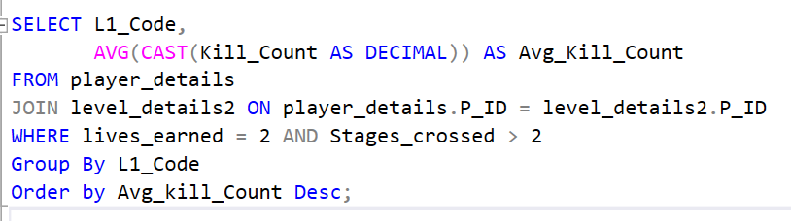
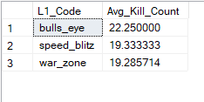
Q2) Find Level1_code wise Avg_Kill_Count where lives_earned is 2 and atleast 3 stages are crossed.
output

Slide 8
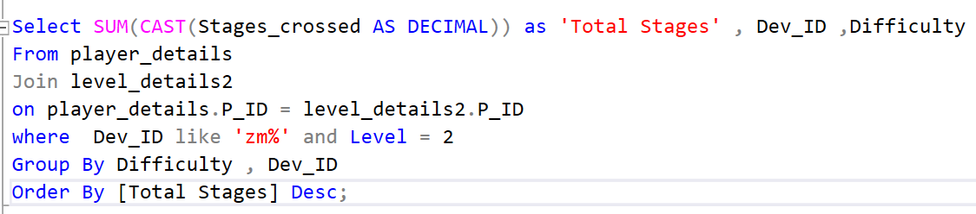
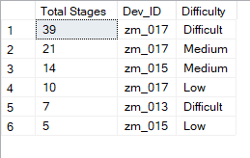
Q3) Find the total number of stages crossed at each diffuculty level where for Level2 with players use zm_series devices. Arrange the result in decsreasing order of total number of stages crossed.
output

Slide 9
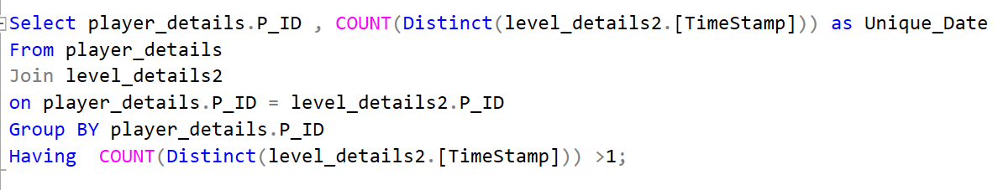
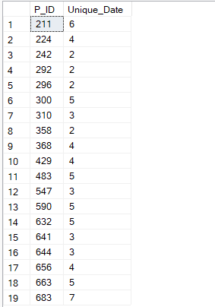
Q4- Extract P_ID and the total number of unique dates for those players who have played games on multiple days.
output

Slide 10
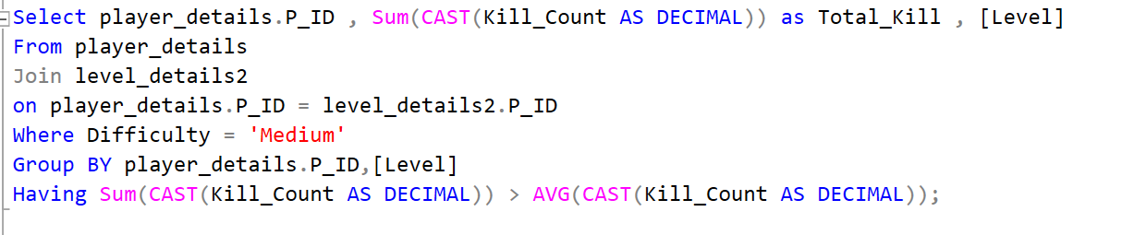
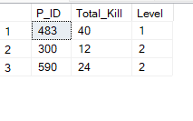
Q5 - Find P_ID and level wise sum of kill_counts where kill_count is greater than avg kill count for the Medium difficulty.
output

Slide 11
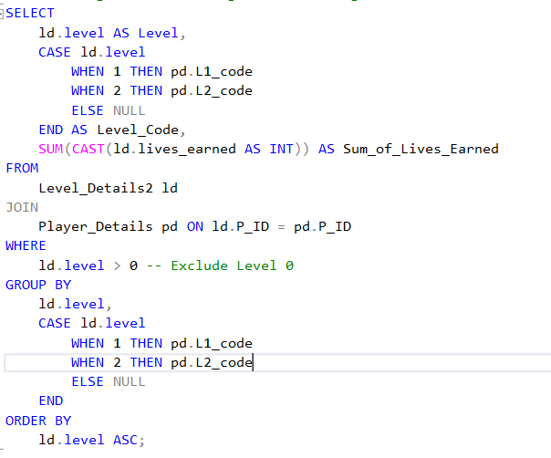
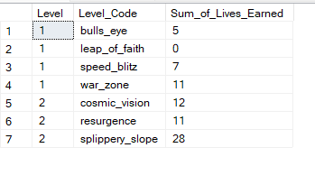
Q6- Find Level and its corresponding Level code wise sum of lives earned excluding level 0. Arrange in asecending order of level.
output

Slide 12
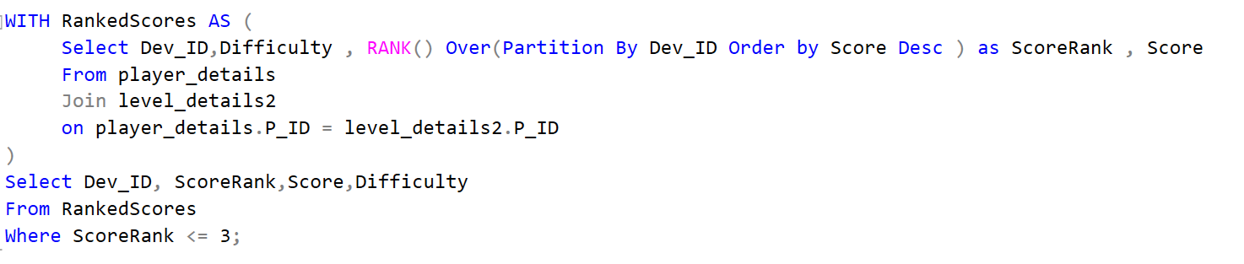
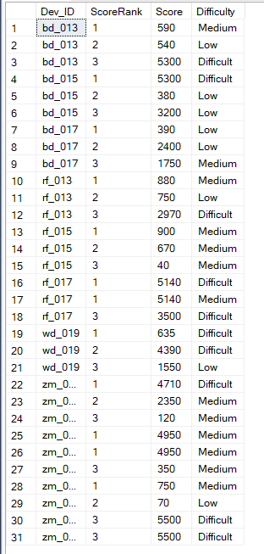
Q7- Find Top 3 score based on each dev_id and Rank them in increasing order using Row_Number. Display difficulty as well.
output

Slide 13
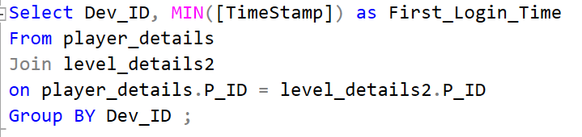
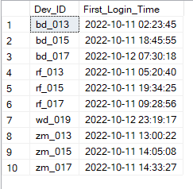
Q8) Find first_login datetime for each device id.
output

Slide 14
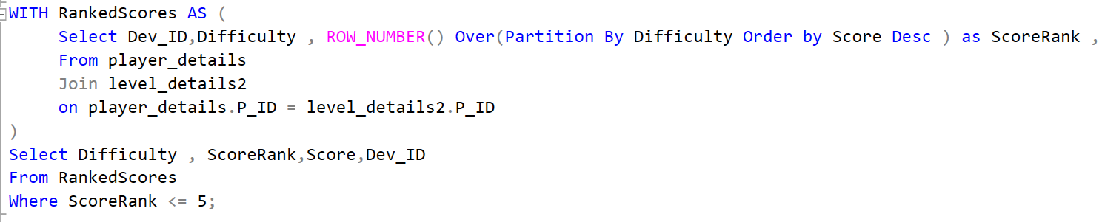
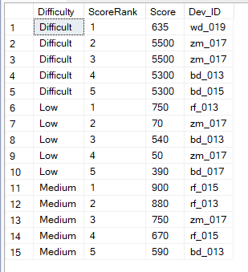
Q9) Find Top 5 score based on each difficulty level and Rank them in increasing order using Rank. Display dev_id as well.
output

Slide 15
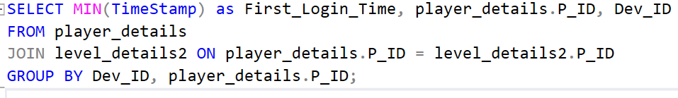
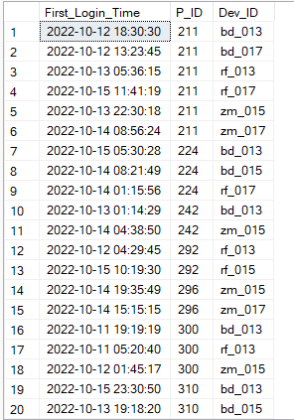
Q10) Find the device ID that is first logged in(based on start_datetime) for each player(p_id). Output should contain player id, device id and first login datetime.
output

Slide 16
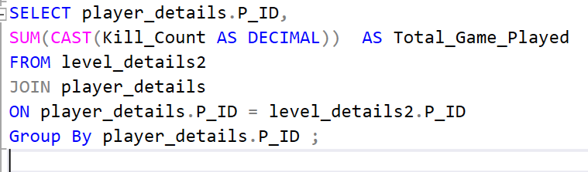
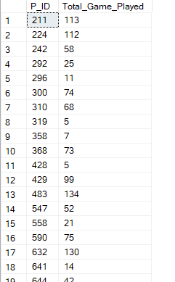
Q11) For each player and date, how many kill_count played so far by the player. That is, the total number of games played -- by the player until that date.
output

Slide 17
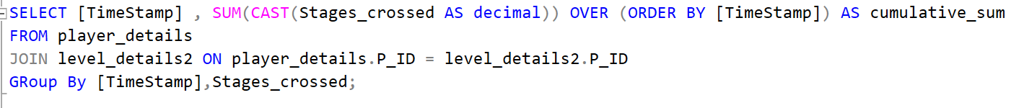
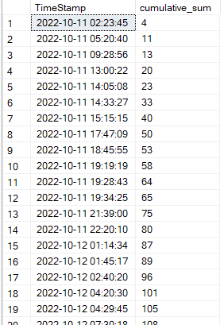
Q12) Find the cumulative sum of stages crossed over a start_datetime.
output

Slide 18
Q13) Find the cumulative sum of an stages crossed over a start_datetime for each player id but exclude the most recent start_datetime.
SELECT [TimeStamp] ,player_details.P_ID, SUM(CAST(Stages_crossed AS decimal)) OVER (ORDER BY [TimeStamp]) AS cumulative_sum
FROM player_details
JOIN level_details2 ON player_details.P_ID = level_details2.P_ID
GRoup By [TimeStamp],Stages_crossed,player_details.P_ID
Having [TimeStamp] < Max([TimeStamp]);
There is no such value. Output is empty.

Slide 19
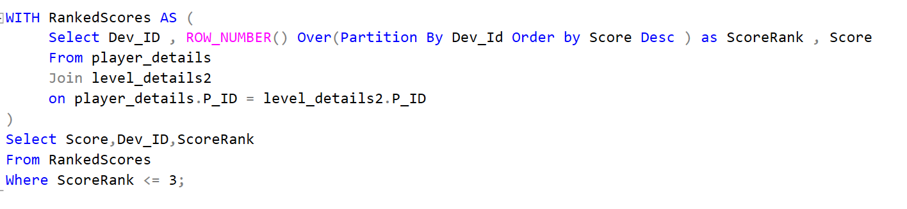
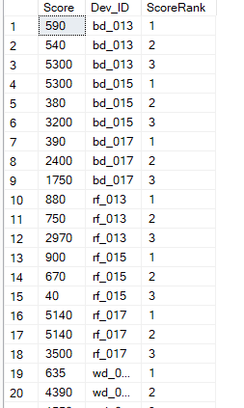
Q14) Extract top 3 highest sum of score for each device id and the corresponding player_id.
output
We will get 30 rows showing score and their top 3 ranks for each Dev_ID.

Slide 20
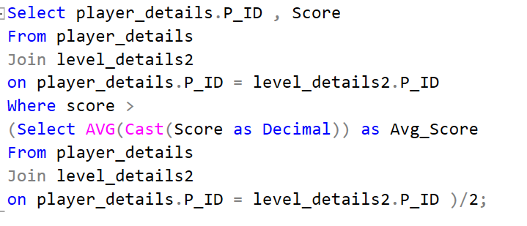
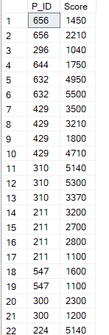
Q15) Find players who scored more than 50% of the avg score scored by sum of scores for each.
We will get 50 rows in output that means there are 50 P_ID that have scored more than 50% of the AVG_SCORE.
output

Slide 21

This Photo by Unknown Author is licensed under CC BY

